Slide 1
Course Selection and Bidding
Office of the Registrar

Slide 2
JD Requirements This information is intended to be an overview. Complete requirements may be found in the YLS Bulletin
Notes:
Brief overview of the Juris Doctor graduation requirements and information on course selection.

Slide 3
JD Requirements: 83 total
51 graded units
9 graded units in the second term
Maximum 10 units Supervised Research and Reading
Maximum 4 units reading groups
Maximum 12 units of non-LAW courses
Maximum 6 units of language courses
Minimum 12 units, maximum 16 per term
Notes:
Non-law courses include courses in other Yale schools or Yale College, as well as joint-degree credit.

Slide 4
Required Courses
First-term courses
Constitutional Law
Contracts
Procedure
Criminal Law & Administration
Torts and Regulation
A course of at least two units satisfying the professional responsibility requirement
Six units of coursework satisfying the experiential requirement
For students matriculating Fall 2023 and later:
Educational experience on bias, cross-cultural competency, and racism (may be co-curricular)
Notes:
First-term assigned to you
After the first-term, wide open

Slide 5
Writing Requirements
SAW and Substantial papers:
Must be written for a course or supervised research
Faculty title determines supervision
Substantial Paper
Minimum 2 units
May be graded CR/F
Supervised Analytic Writing Paper
Minimum 3 graded units
Grade of Pass or higher

Slide 6
Fifth-Term Writing Requirement
One paper must be graded and certified before you may return to YLS for your penultimate term
August 1st
Except for joint-degree and off-cycle students

Slide 7
ABA Standard 303-1
You may not use a course to satisfy more than one YLS graduation requirement
Experiential units
Professional Responsibility
Substantial Paper
Supervised Analytic Writing
Clinical seminar + fieldwork = a course

Slide 8
Keep in Mind…
Review requirements on YLS:Courses
Review your Degree Audit
For example:
Clinical fieldwork and seminar units

Slide 9
Spring 2024 Registration Timeline
After Thanksgiving
Early December
November 2 to November 9
Early January
First week of spring term
Students submit bids
Faculty review materials
Students review results
Accepted courses on Yale Hub, transcript and Canvas
Add/drop on Yale Hub
Lotteries run
Accept and decline
Course Bidding
Drop courses without late drop policies
Accept/decline waiting list offers
Add Supervised Research, reading groups
Add courses with seats available
Notes:
Pre-registration is just the first step in the process. You will have multiple opportunities to register for classes and coursework.

Slide 10
Course Information and Selection Using YLS:Courses

Slide 11
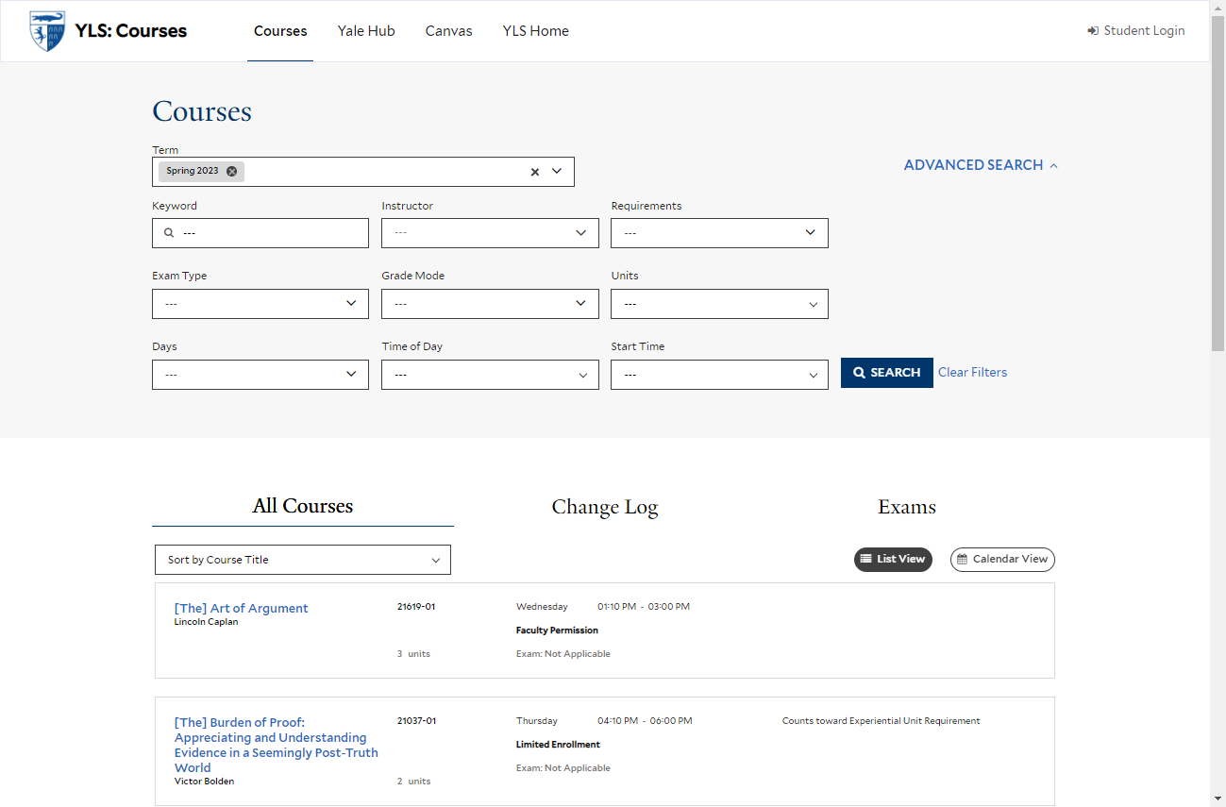
YLS:Courses | courses.law.yale.edu

Slide 12
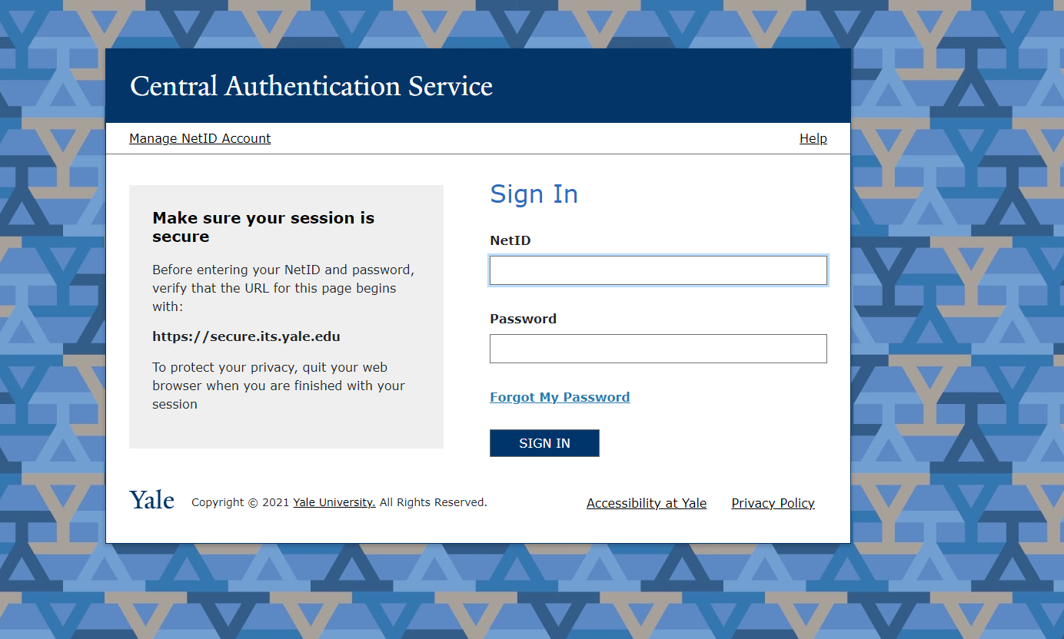
YLS:Courses | Login
Notes:
You will see different information when logged in, and you must log in to select courses when bidding is open.

Slide 13
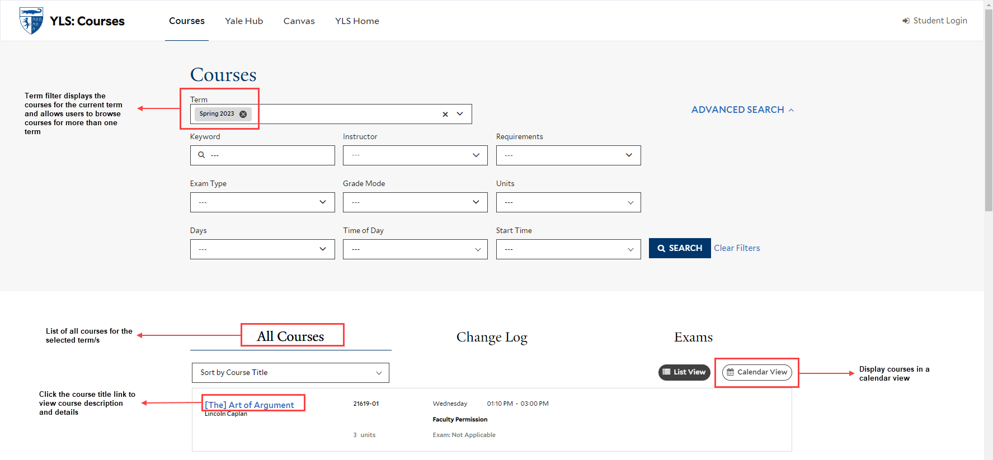
YLS:Courses | Home

Slide 14
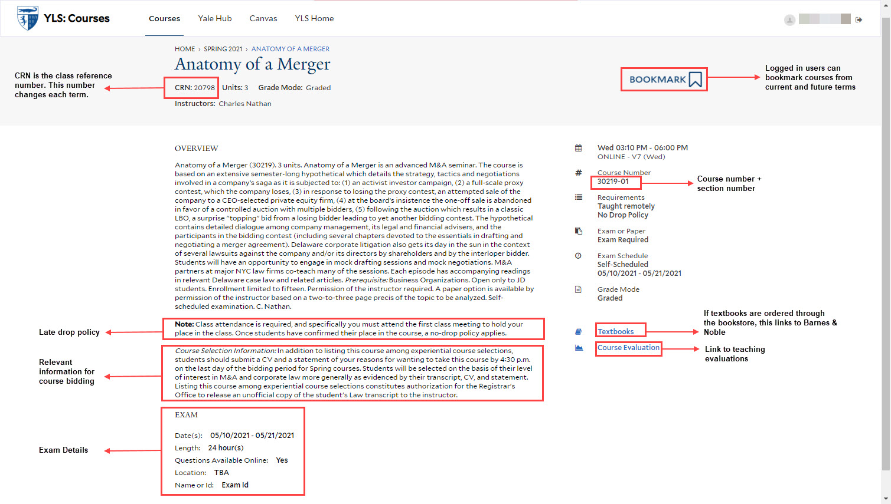
Course Description and Details

Slide 15
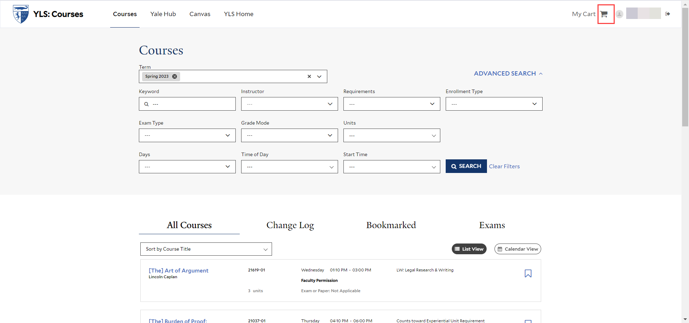
Bidding Opens
Notes:
When bidding is open, your course selection cart will appear at the top right of the page.

Slide 16
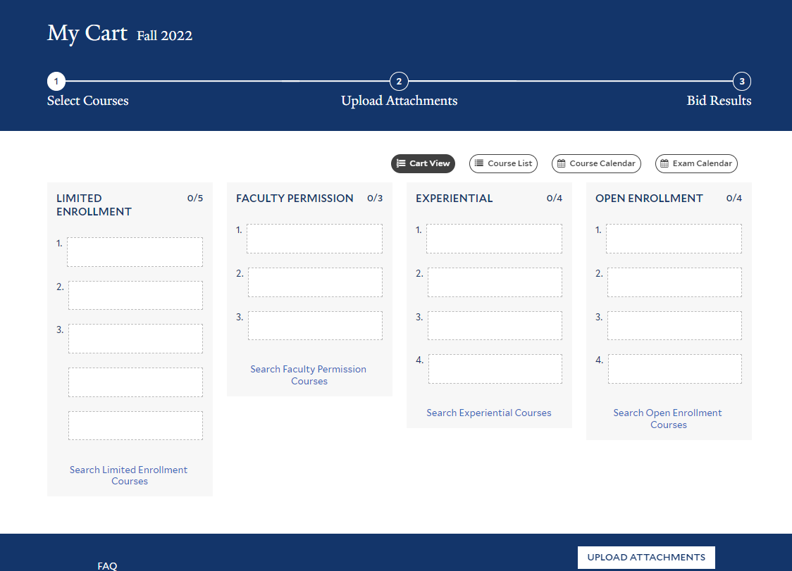
Your Course Selections

Slide 17
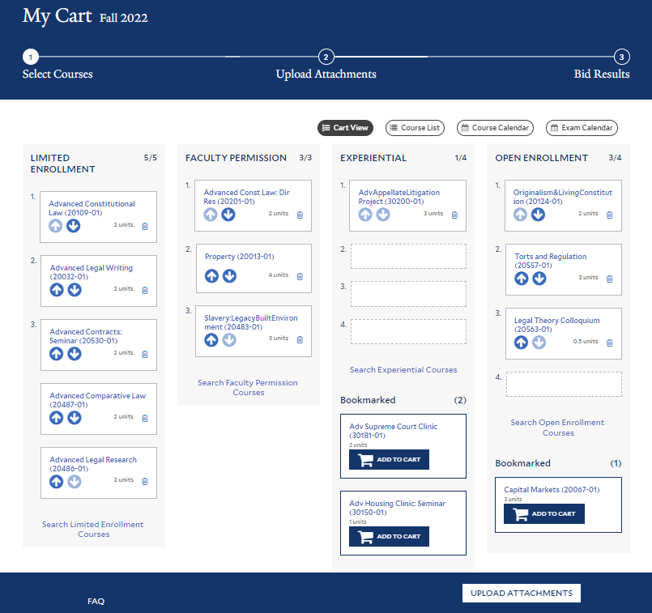
Your Course Selections, cont.
You are not required to submit course selections for every enrollment category, or for the maximum number of courses.
Notes:
Bookmarks are not considered. You can drag and drop the course selections to reorder, or use the delete icon to remove a course from your cart.
There are four enrollment categories. Each enrollment category has slightly different rules for how students are allocated or selected for the course.

Slide 18
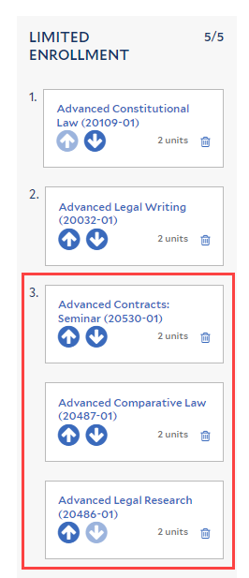
Limited Enrollment Bid Selections
Limited enrollment courses follow the default rules based on bid number and class year, unless stated otherwise in the course description.
Notes:
One first choice and one second choice and three third choice bids

Slide 19
Limited Enrollment Bid Selections
Default Rules
Students are allocated courses on the basis of the bids they express.
Anyone listing a course as a third choice will not be selected before those listing it as a higher choice; likewise, no one listing a course as a second choice will be selected before those listing it as a first choice.
Where the default procedure does not yield the appropriate number of students for the course, the computer program gives preference to students in their last year at the law school and thereafter chooses randomly.
Notes:
Maximize enrollment in the course. If a course is oversubscribed, the algothrim will consider bid rank first. If the course is over subscribed with students who ranked the course first, we will give preference to students in their final year of student (third-year and LLM students). Similarly, if a course is over subscribed, the waiting list will be generated in rank order, and students in their final year of students will be given preference within the bid rank. Within bid rank, first-year and second-year students are treated equally.

Slide 20
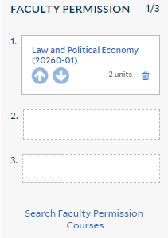
Permission of the Instructor
Permission of the instructor courses may require additional materials.
Professors may use selection weight as a factor in making enrollment decisions.

Slide 21
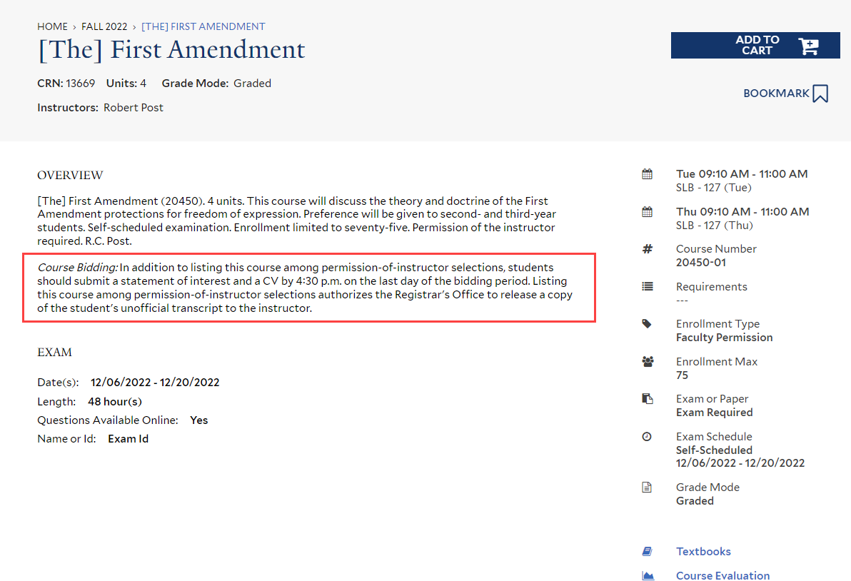
Permission of the Instructor
Permission of the instructor courses may require additional materials.
Professors may use selection weight as a factor in making enrollment decisions.
Notes:
Be sure to review the course description and upload the supplementary materials. If a permission of the instructor course does not specify supplementary materials, the Registrar’s Office may contact students who selected the course if the course is oversubscribed and ask for a statement of interest at that time.

Slide 22
Permission of the Instructor
Permission of the instructor courses may require additional materials.
Professors may use selection weight as a factor in making enrollment decisions.

Slide 23
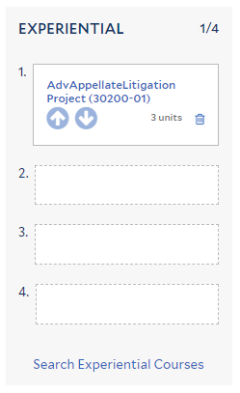
Experiential Courses
Experiential courses may require additional materials.
Professors may use selection weight as a factor in making enrollment decisions.

Slide 24
Experiential Courses
Experiential courses may require additional materials.
Professors may use selection weight as a factor in making enrollment decisions.

Slide 25
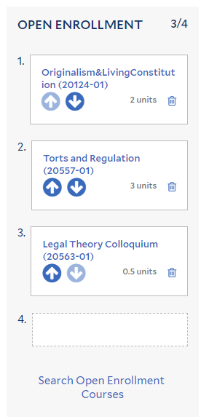
General or Open Enrollment Courses
Open enrollment courses may have a cap.
Notes:
Open enrollment courses are generally the larger lecture courses, and instructors have no preference as to which students enroll. Open enrollment courses, unless they are oversubscribed and have a waiting list, may be added during online add/drop.

Slide 26
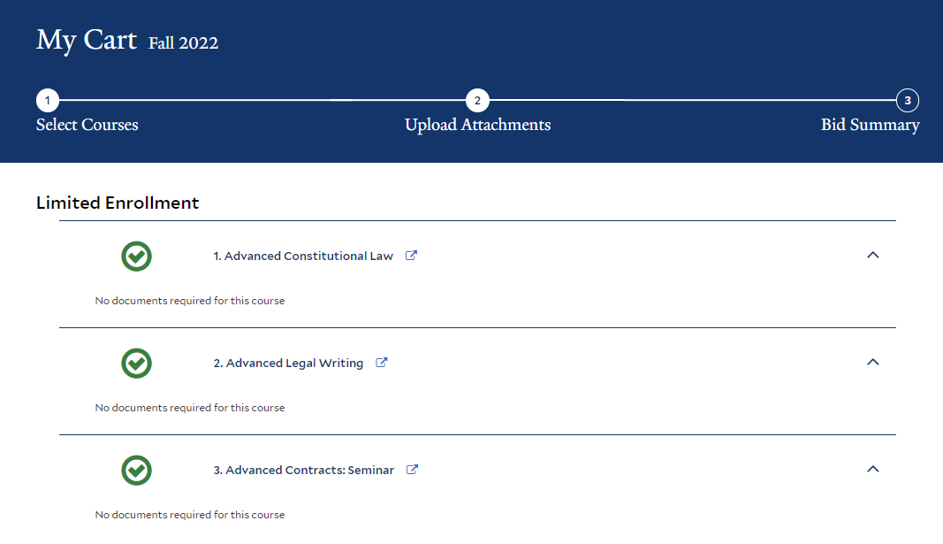
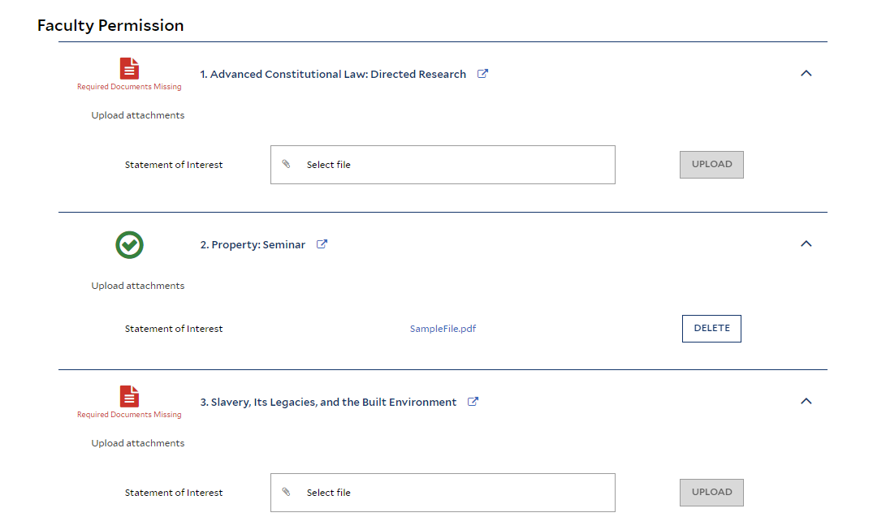
Attachments
Notes:
Once you’ve selected the courses, click on the Upload Attachments section at the top.

Slide 27
Attachments
Notes:
Upload a PDF file by clicking on the select file button and selecting the attachment. Clicking on the title of the file will download the document. Be sure you’ve uploaded the correct file.

Slide 28
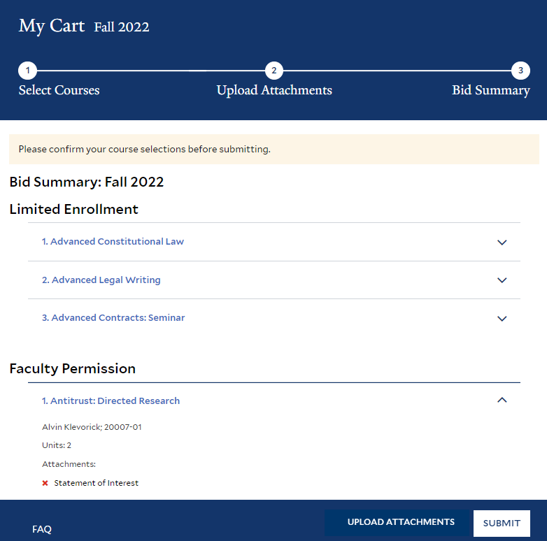
Submit Bids
Once you submit your bids, no changes can be made!
Unsubmitted bids will NOT be considered.
Notes:
Click on the third step, submit bids to submit your course selections.

Slide 29
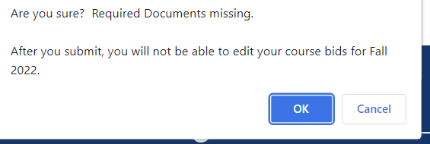
Confirm Submission
Once you submit your bids, no changes can be made!
Unsubmitted bids will NOT be considered.
Notes:
You will get a pop up after you click the submit button. There is no advantage to submitting your course selections early. However, if your bids are not submitted by 4:30pm on the day bidding closes, they will not be considered. Once you submit your bids, no changes may be made. You should receive an email confirmation with your course selections. Please review the email carefully.

Slide 30
What Happens Next?

Slide 31
What Happens Next?
Faculty review application materials
Limited rules applied
Open or general rules applied after results from permission and experiential bids received
Email notification of bid results
Confirm/decline places on YLS:Courses
Accepted courses pushed to Yale Hub prior to add/drop
Add/drop first week of semester (in Yale Hub)

Slide 32
Courses Outside the Law School
Yale Course Search https://courses.yale.edu/
All non-law courses require instructor approval, sponsoring law professor, and Registrar permission via online form.
SOM courses require separate non-SOM student request form.
Jackson courses require separate Jackson request form.
More information available on the Registrar’s Office web site.

Slide 33
Supervised Research/Reading
Supervised Research for academic work
May be graded or credit/fail
Supervised Research for RA work
Credit/fail
Talk to the faculty member first
Add on Yale Hub during online add/drop
Complete Supervised Research Form
Units are determined by the sponsoring faculty
Faculty title determines eligibility

Slide 34
Frequently Asked Questions
Variable unit courses
Added to schedule with minimum units
Faculty may adjust units, generally at the end of the term when the work is complete
Change of grading basis
Firm deadline
Check YLS:Courses, Yale Hub for current grade mode

Slide 35
Registration Resources

Slide 36
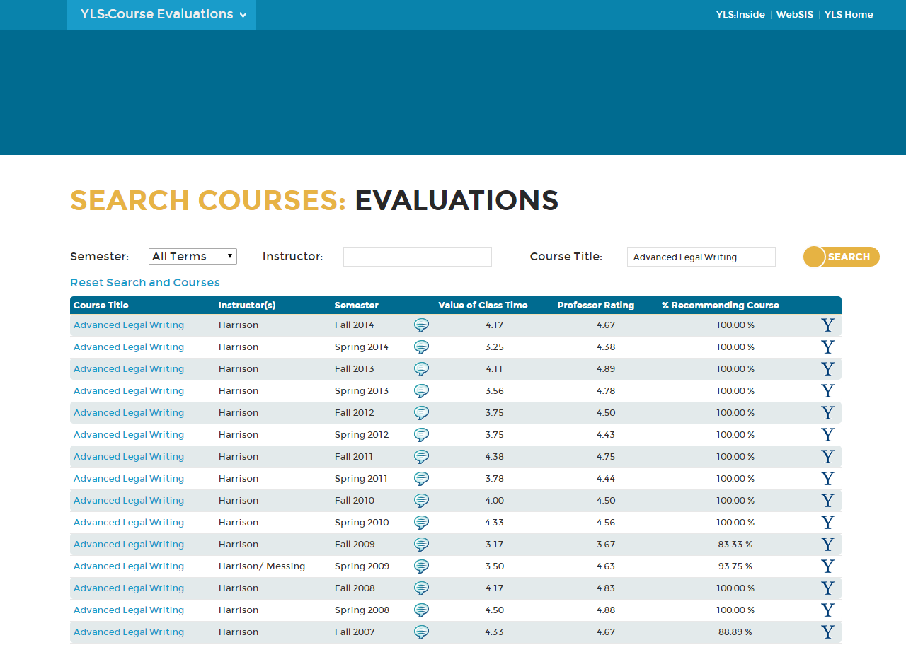
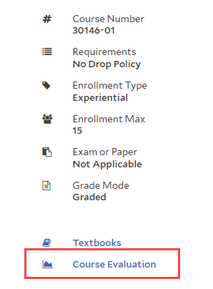
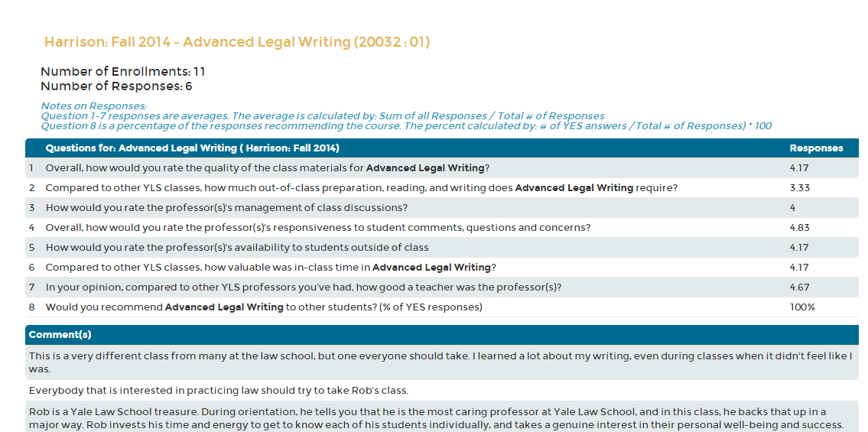
Course Evaluations

Slide 37
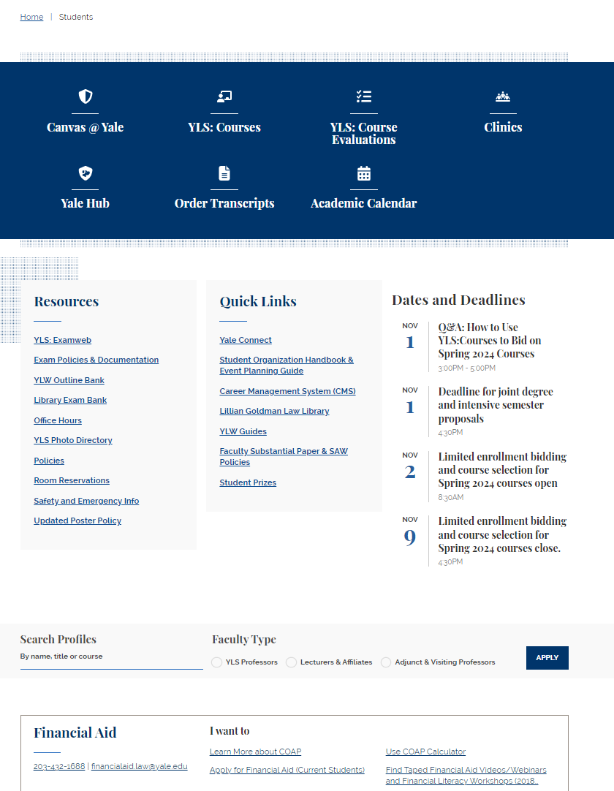
YLS Student Portal| law.yale.edu/students

Slide 38
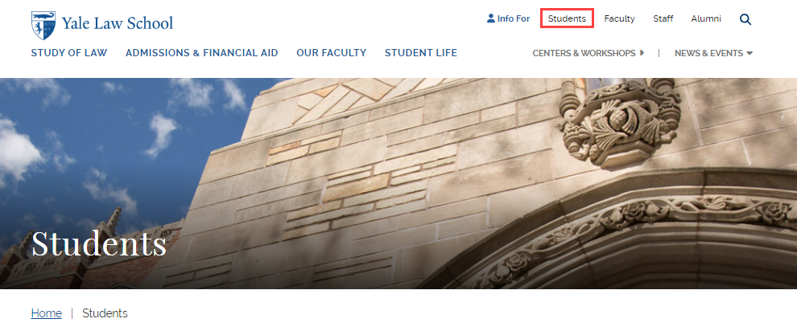
YLS Student Portal| law.yale.edu/students

Slide 39
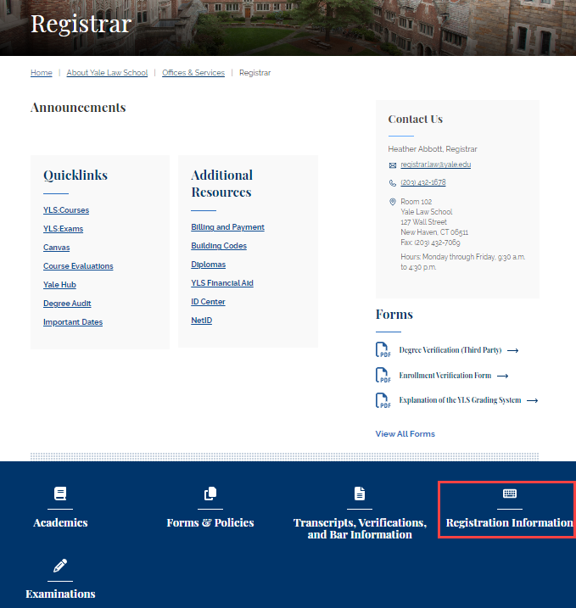
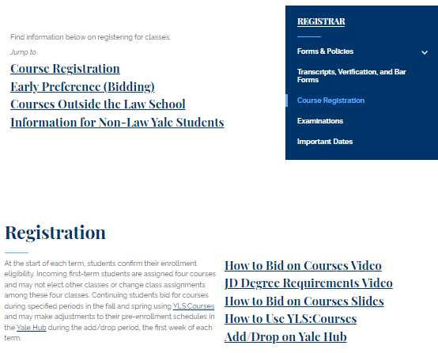
YLS Registrar’s Office | law.yale.edu/registrar

Slide 40
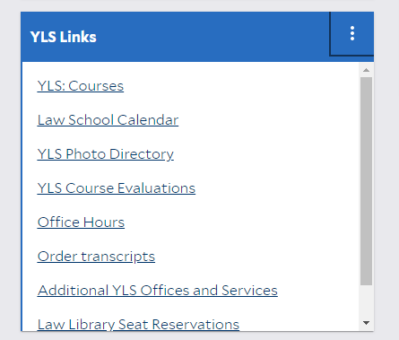
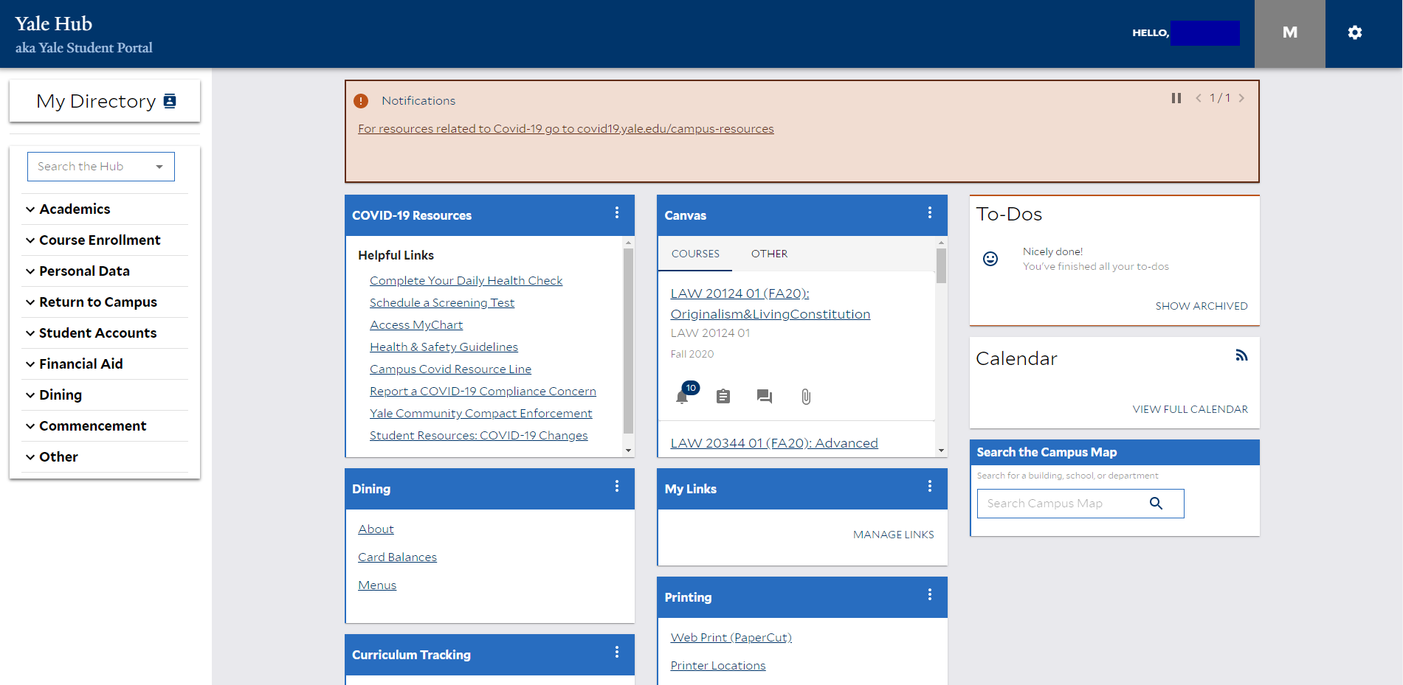
Yale Hub | yub.yale.edu

Slide 41
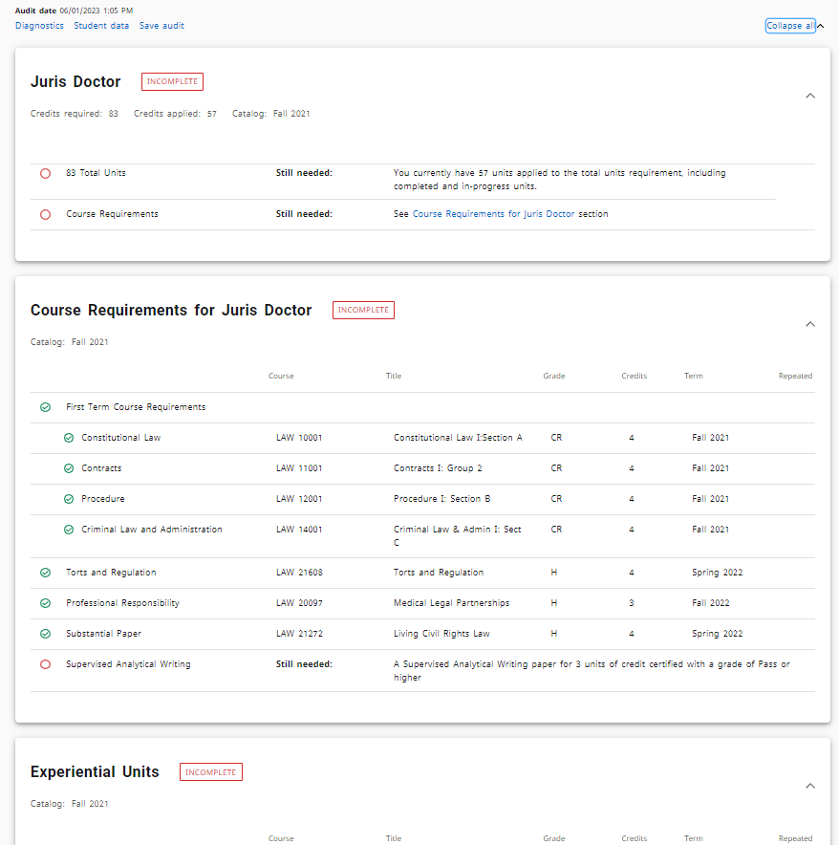
Degree Audit | degreeaudit.yale.edu

Slide 42
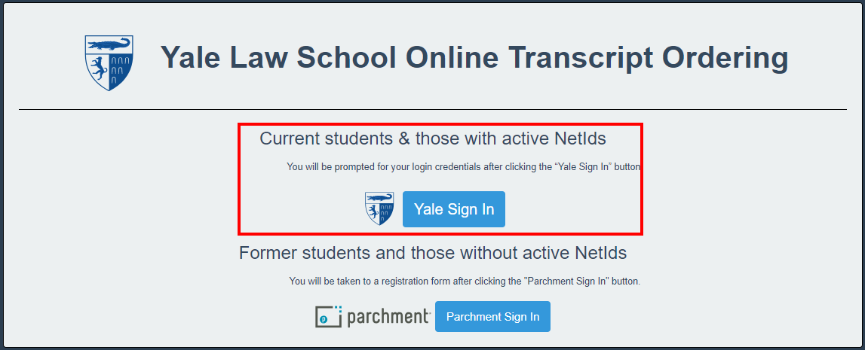
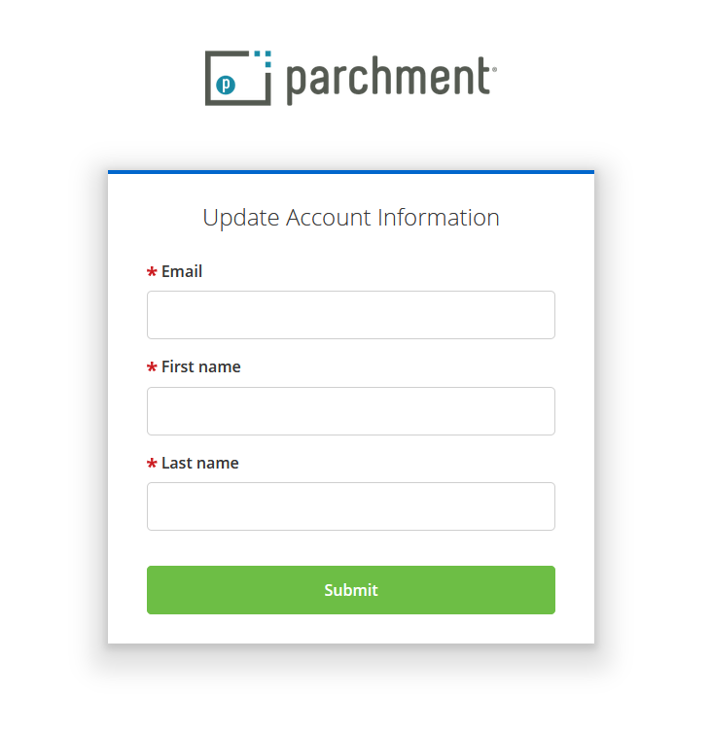
Ordering Transcripts | transcript.law.yale.edu

Slide 43
Questions? registrar.law@yale.edu

